Slide 1
RETOOLING OF SENIOR SCHOOL TEACHERS
INTERPRETATION OF CURRICULUM DESIGN
AUGUST, 2025

Slide 2

KWL
1. What do I know about the Curriculum Design?
2. What do I want to know about the Curriculum Design?
Notes:
The outcome is linked to the outcome of the previous session on Audio based and video based modes of remote learning
2

Slide 3
Curriculum Design
A Curriculum Design is a document that outlines the components or elements of a curriculum.
It’s a core document that guides learning institutions on how to organise learning.
A Curriculum Design provides details that show the relationship between the components.
Curriculum Designs ensure the curriculum can be implemented within the time allocated and with the infrastructure in the schools.

Slide 4
Components of a Curriculum Design
Preliminary Information
National goals of Education
Level Learning Outcomes (senior school)
List of subjects
Lesson Distribution
Essence statements
Subject General Learning Outcomes
Summary of Strands and Sub-strand

Slide 5
Components of a Curriculum Design
Strand | Sub Strand | Specific Learning Outcomes | Suggested Learning Experiences | Key Inquiry Question(s)
Core competences to be developed:
Values:
Pertinent and Contemporary Issues(PCIs):

Slide 6
Strand and sub strands
Strand: A strand is a broad category or domain within a curriculum design that represents a major area of learning. Strands typically encompass a group of related knowledge, skills and attitudes.
For example:
The Senior School Curriculum Design for Agriculture has 3 Strands, namely; Crop Production, Animal Production, and Agricultural Technologies and Entrepreneurship.
Sub strand: A sub-strand is a more specific subset or subdivision within a larger strand. It further breaks down the content or competency areas into more focused and manageable components.

Slide 7
Learning Outcomes
Learning outcomes are the end result or what the learner is able to demonstrate upon completion of a lesson, sub strand, strand or level.
Learning outcomes express what a learner is expected to do after going through a learning experience.
They indicate the expected observable behavioural changes in the learner after a learning experience.
Learning outcomes are expressed through the application of knowledge, skills and attitudes.

Slide 8
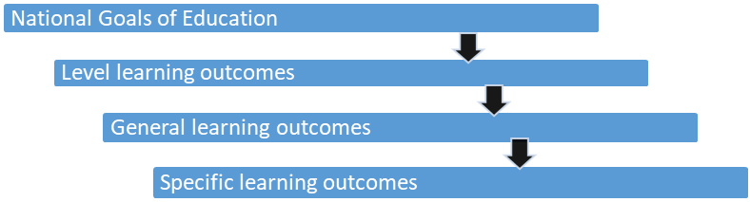
Progression of Learning Outcomes

Slide 9

Activity
Access the Grade 10 Curriculum Designs from the KICD Website at https://kicd.ac.ke/cbc-materials/curriculum-designs/grade-ten/ and select a Subject. Using the selected Curriculum Design;
Pick on any National Goal of Education.
Identify one Level Learning Outcome that will assist in the realization of the National Goal of Education selected in No. 2
Identify one subject General Learning Outcome that will aid the realisation of the Level Learning Outcome you identified in No. 3
Pick one specific learning outcome that will help achieve the subject General Learning Outcome identified in No. 4

Slide 10
Designing Learning Outcomes
A good learning outcome begins with an action verb, followed by the object of the verb and a phrase that gives the context.
Preferably only one verb is used in a learning outcome.
The learning outcomes should be observable.
Learning outcomes are amenable to assessment.
Avoids vague terms like know, understand, learn, be familiar with, be exposed to, be acquainted with, and be aware of.

Slide 11
Learning Outcomes must develop the following
KNOWLEDGE
Acquisition of facts, ideas, concepts; their application, synthesis to get new ideas and evaluation of the information
SKILLS
Using the knowledge acquired, a learner is able to apply it to perform certain tasks against a given standard. The standard to which a learner should perform the task is referred to as a competence.
VALUES
Desirable beliefs and personal attributes that a learner acquires through knowledge and skill that influence performance.

Slide 12
The ‘verb’ in a learning outcome
The verb represent the three domains of learning including knowledge, skills and attitudes.
Example:
Subject: Home Science (Grade 10)
Strand 2.0: Home Management
Sub strand 2.1: Hygiene Practices During Puberty
By the end of the sub-strand the learner should be able to:
explain ways of cleaning the house,
clean different rooms in the house using appropriate methods,
appreciate the importance of living in a clean house.

Slide 13
The ‘object’ in a learning outcome
The learning outcome also has an object, which answers the question “what”
Example:
Subject: Home Science (Grade 10)
Strand 2.0: Home Management
Sub strand 2.1: Hygiene Practices During Puberty
By the end of the sub-strand the learner should be able to:
explain ways of cleaning the house,
clean different rooms in the house using appropriate methods,
appreciate the importance of living in a clean house.

Slide 14
The ‘context’ in a learning outcome
The learning outcome also has a context, which answers the question “why”, “where”, “how” and “when”
Example:
Subject: Home Science (Grade 10)
Strand 2.0: Home Management
Sub strand 2.1: Hygiene Practices During Puberty
By the end of the sub-strand the learner should be able to:
explain ways of cleaning the house,
clean different rooms in the house using appropriate methods,
appreciate the importance of living in a clean house.

Slide 15
Specific Learning Outcomes (SLOs)
Since CBE is learner - centered and activity - oriented, the SLOs are designed such that:
the outcome statement includes a verb that will clearly illustrate what action learners need to engage in to demonstrate their competencies.
the action should demonstrate a change at the level of knowledge, a skill or an attitude.

Slide 16
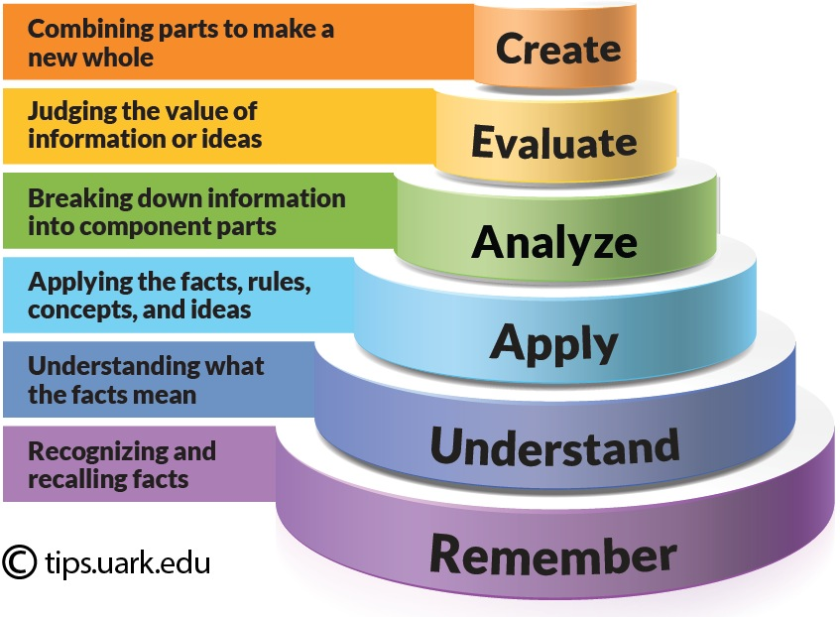
Formulating Specific Learning Outcomes

Slide 17
Formulating Specific Learning Outcomes
Bloom’s Level | Key Verbs (keywords) | Example Learning outcome
Create | design, formulate, build, invent, create, compose, generate, derive, modify, develop. | Design a garment for a new born baby
Evaluate | choose, support, relate, determine, defend, judge, grade, compare, contrast, argue, justify, support, convince, select, evaluate. | Choose foods rich in vitamin C in their locality
Analyze | classify, break down, categorise, analyse, diagram, illustrate, criticise, simplify, associate. | Differentiate between macro and micro nutrients found in foods.
Apply | calculate, predict, apply, solve, illustrate, use, demonstrate, determine, model, perform, present. | Calculate BMI for promoting health.
Understand | describe, explain, paraphrase, restate, give original examples of, summarise, contrast, interpret, discuss. | Describe materials used to build homes.
Remember | list, recite, outline, define, name, match, quote, recall, identify, label, recognise. | Recite the national anthem of Kenya.

Slide 18
Group Activity:
Breaking Specific Learning Outcomes (SLOs) into Lesson Learning Outcomes (LLOs)
Select a Curriculum Design for any subject in Grade 10 from https://kicd.ac.ke/cbc-materials/curriculum-designs/grade-ten/
Choose a sub strand that has more lessons and the number of specific learning outcomes.
Break down the specific learning outcomes into teachable lesson learning outcomes for the required number of lessons.
Present in plenary.

Slide 19
Learning Experiences
Learning experiences are activities or tasks that the trainee should carry out in order to develop desired knowledge, skills, values and attitudes
Learning experiences focus on developing the trainees cognitive, physical and emotional domains.
They are interactions in which learning takes place.
“Learning Experience is the interaction between the learner and external conditions in the environment to which he/she can react.” - Ralph Tyler

Slide 20
What informs Learning Experiences?
`
Learning Experiences
Prior Knowledge
Learning Styles
Differentiated Learning
Multiple intelligence theory

Slide 21
Factors to Consider in Selection of Learning Experiences
`
Relevance to intended learning outcomes
Time required for the experience
Developmental age level
Learning resources
Safety

Slide 22
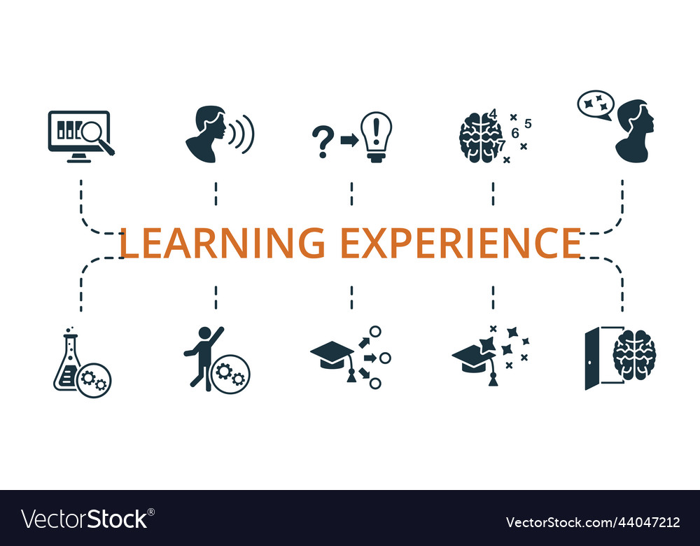
Group Activity: Learning Experiences
From the Lesson Learning Outcomes generated in the previous group activity,
Generate Learning Experiences to achieve the Lesson Learning Outcomes
Present in plenary.

Slide 23

Key Inquiry Questions (KIQs)
Key inquiry questions form the foundation of Inquiry-Based Learning (IBL), a critical methodology in Competency Based Education (CBE) as it involves asking questions.
Such questions help the learner retain information and invariably encourage them to investigate concepts under study by asking further questions about what they are learning.

Slide 24
What kind of Questions are KIQs?
These are questions that help to focus on learning.
Questions that probe for deeper meaning and set the stage for further questioning
Foster the development of critical thinking skills and higher order capabilities such as problem solving.
Questions that originate from curiosity and engagement with subject matter.

Slide 25
What Makes a Good KIQ
It is open-ended, non-judgmental, meaningful and purposeful with an aim to allow learners to explore ideas.
Is thought-provoking and intellectually engaging, often sparking discussion and debate.
Encourages collaboration amongst learners, teachers, and the community.
Integrates technology to support the learning process particularly through the search for more information.

Slide 26
What Makes a Good KIQ
Call for higher-order thinking, such as analysis, inference, evaluation, prediction. It cannot be effectively answered by recall alone.
Point toward important, transferable ideas within and even across subjects or learning areas.
Raise additional questions and sparks further inquiry.
Requires support and justification, not just an answer.

Slide 27

Question Words to Use
Utilize the six typical question words:
How?
Why?
Who?
Where?
When?
What?

Slide 28

Group Activity: KIQs
From the Lesson Learning Outcomes generated in the previous group activity,
Generate at least 2 Key Inquiry Questions (KIQs)
Present in plenary.

Slide 29
Mainstreaming Core Competencies, Values and PCIs in the Learning Experiences
Core Competencies are key skills and abilities that learners need to develop to succeed in the 21st century. These competencies aim to provide a holistic education that prepares students for the demands of modern life.
Values are principles or standards of behavior that guide individuals in making decisions, building relationships, and conducting themselves in a manner that is considered morally and socially acceptable.
Pertinent and Contemporary Issues (PCIs) refer to the current and significant challenges or topics that impact society and require attention and action.

Slide 30
Mainstreaming Core Competencies, Values and PCIs in the Learning Experiences
Mainstreaming is the process of identifying suitable opportunities to incorporate the development of Core Competencies, nurture Values and address Pertinent and Contemporary Issues (PCIs) in the learning experiences.
Core Competencies, Values and PCIs to be mainstreamed in the learning experiences are clearly outlined in the curriculum designs for proper guidance.

Slide 31
Mainstreaming Core Competencies
The competency-based approach to learning is intended to develop in the learner:
‘the ability to apply appropriate knowledge and skills to successfully perform a function’
Learners are enabled to make connections between the knowledge they acquire and how they can use it meaningfully within a given context.
Learning therefore becomes more purposeful and relevant to real life situations.

Slide 32
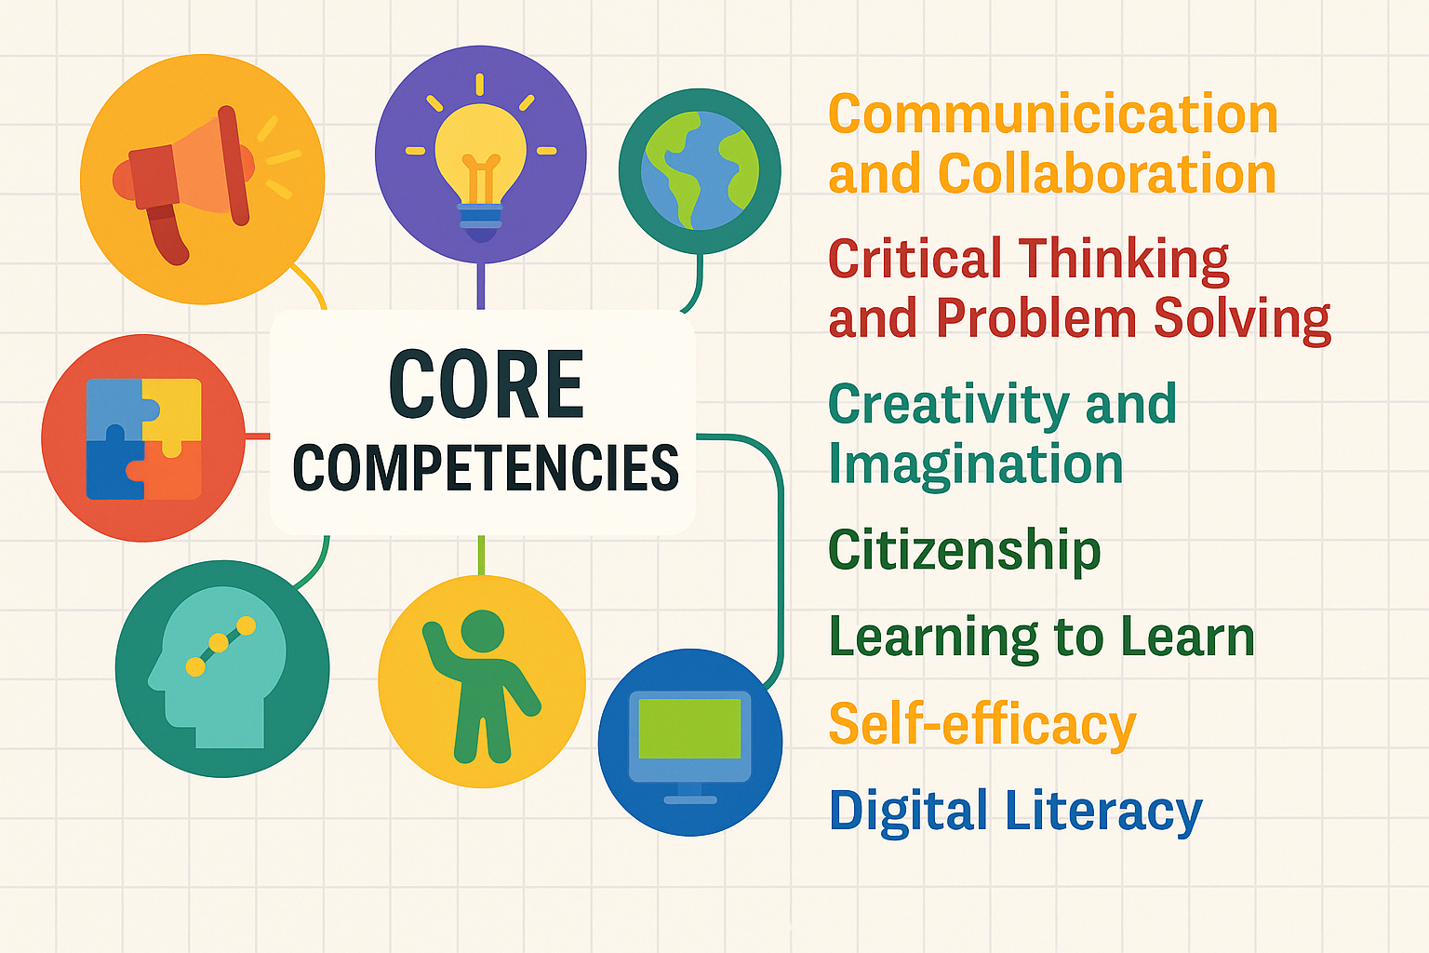
Core Competencies
CBE has identified 7 Core Competencies
Communication and Collaboration
Critical Thinking and Problem Solving
Creativity and Imagination
Citizenship
Learning to Learn
Self-efficacy
Digital Literacy

Slide 33
1. Communication and Collaboration
Embed learning experiences that will make learning take place collegially, in a group or a team
Present opportunities for learners to:
express themselves orally and in writing
listen attentively
argue out an opinion and defend his or her views
share knowledge/resources with others and seek the same from them
contribute to the team’s objectives
justify course or action taken.

Slide 34
2. Critical Thinking and Problem Solving
Structure learning around situations that will require learners to use logic and evidence to arrive at conclusions or solve problems
Create scenarios for learners to:
demonstrate objective ideas, opinions and views
use evidence to draw conclusions
innovate to solve problems in line with their age
explore options/new ways of doing common chores
generate and implement ideas individually and/or collectively to seek solutions to a contextual problem
demonstrate open mindedness to new ideas and opinions
adopt multifaceted dimensions and make multiple attempts to solving a contextual issue

Slide 35
3. Citizenship
Create a learning environment that will require learners to demonstrate their rights, privileges, and duties as citizens.
Engage them in activities requiring them to:
value a sense of identity with others
uphold identity with peers
respect and uphold rights of others
operate within their own rights
responsibly claim their own rights and privileges
undertake duties and obligations
express own belonging among others
seek peace while resolving conflicts with others
demonstrates tolerance in resolving controversies
demonstrates some level of understanding when own rights/privileges are infringed.

Slide 36
4. Digital Literacy
Expose learners to a wide range of content and devices to equip them with knowledge, skills and behaviours which are effective and safe for digital literacy.
Explore opportunities in and out of school for learners to progressively:
use digital device communication networks,
engage in online communication and social networks,
become aware of and adhering to ethical behaviour protocols,
get information about societal issues through digital media,
search, evaluate and use information channelled through digital platforms

Slide 37
5. Creativity and Imagination
Exploit learning activities as avenues for learners create new ideas that result in products that add value to their lives and to the lives of those around them.
Diversify the activities to take on board various learners’ inclination to:
form and communicate / present idea (writing, sketching, gestures)
translate ideas to real items (drawing, sculpture, model, design)
present multiple dimensions as a single idea
compile other people’s ideas to a concrete image
compile ideas to develop a concept
patch-up ideas to a concrete course/solution/concept
analyse a broad idea into component ideas
innovate a model/item from own or others ideas

Slide 38
6. Learning to Learn
Regularly remind learners that learning is a continuous process that requires personal organization, effective management of time and information, both individually and in groups.
Provide tasks that will challenge learners to:
show openness to new ideas
critique his or her own ideas
use one idea as a learning experience to a new idea
continuously demonstrate personality progress
use new opportunities as a learning experience to expound knowledge and skills
progressively adopt new value, beliefs and opinion structures
persistently pursue new targets and more challenging goals
work progressively to overcome existing obstacles
seek assistance and guidance to overcome persistent obstacles
adopt and assimilate new knowledge and skills to overcome contextual challenges.

Slide 39
.
7. Self Efficacy
Use the learning environment to instil in learners the belief about their capabilities to perform assigned tasks, prospects for accomplishment and personal well-being.
Develop assignments that give learners chances to:
present ideas with confidence
demonstrate sense of assurance and trust
present self-interest, group interest and /or defend opinions politely
volunteer to undertake challenging tasks
courageously volunteer to take group leadership
demonstrate intrinsic self-motivation
demonstrate self-awareness, responsibility, resource and age-related chore management
confidently protect and conserve personal and group resources

Slide 40

Group Activity
From the Learning Experiences generated in the previous activity, mainstream any 3 Core Competencies in the learning experiences.
Present to plenary.

Slide 41
Mainstreaming Values
Values are standards that guide an individual on how to respond and behave in given circumstances. CBE has identified eight values to be mainstreamed namely;
Love (care and compassion),
Responsibility,
Respect,
Unity,
Peace,
Patriotism,
Social justice and
Integrity (honesty and trustworthiness).
Values are addressed in the Learning outcomes, Key inquiry questions and Learning experiences.

Slide 42
Mainstreaming of Pertinent and Contemporary Issues (PCIs)
There are specific Pertinent and Contemporary Issues (PCIs) for Senior School.
They are divided into four broad categories namely;
Health Promotional Issues
Socio – Economic and Environmental Issues
Citizenship Education
Life Skills, Moral Education and Human Sexuality Education
PCIs are addressed in the Learning outcomes, Key inquiry questions and Learning experiences.

Slide 43

“The heart of effective learning lies in the correct interpretation of the Curriculum Design”
- UNESCO

